Slide 1
Topics (Chapter 7)
Unix: visual in vi
Integer types and Floating types
Integer overflow
type conversion
Type definition
Character

Slide 2
VI: Copy, paste, delete a single line of text, undo, and save/quit
In the regular mode, use command: “yy” and “p” for copy and paste a single line
Make sure you are not in Insert mode by pressing the Esc key. Place the cursor on the line you wish to copy. Type yy to copy the line. Move the cursor to the place you wish to insert the copied line and press p.
In the regular mode, use command: “dd” to delete a line
Make sure you are not in Insert mode by pressing the Esc key. Place the cursor on the line you wish to delete.
Use u to undo

Slide 3
Vi: visual selection for copy, past, and delete
To select a block of text to be copied and pasted:
Position the cursor at the beginning of the text you want to cut/copy.
Press v to begin character-based visual selection, or V to select whole lines
Move the cursor to the end of the text to be cut/copied.
Press y (yank) to copy, press d (delete) to cut.
Move the cursor to the desired paste location.
Press p to paste after the cursor.

Slide 4
Integer Types

Slide 5
Numbers in C: Integer Types Signed and Unsigned Integers
The integer types are divided into two categories: signed and unsigned.
By default, integer variables are signed in C—the leftmost bit is reserved for the sign.
is 0 if the number is positive or zero, 1 if it’s negative.
01111111111111111111111111111111 – positive 2,147,483, 647
10000000000000000000000000000000 – negative 2,147,483, 648
5

Slide 6
Numbers in C: Integer Types Signed and Unsigned Integers
To tell the compiler that a variable has no sign bit, declare it to be unsigned.
unsigned int u_num;
Unsigned numbers are primarily useful for systems programming and low-level, machine-dependent applications.

Slide 7
Integer Types
Typical ranges:
Type Smallest Value Largest Value
short int –32,768 32,767
int –2,147,483,648 2,147,483,647
long int –9223372036854775808 9223372036854775807
7

Slide 8
Format specifiers for integers in scanf and printf
For both printf and scanf
For type short int
Use %hd
For type int
Use %d
For type long int
Use %ld

Slide 9
Integer Overflow
9
When arithmetic operations are performed on integers, it’s possible that the result will be too large to represent.
For example, when an arithmetic operation is performed on two int values, the result must be able to be represented as an int.
If the result can’t be represented as an int, we say that overflow has occurred.

Slide 10
Integer Overflow
long i;
int j = 1000000;
i = j * j; /* overflow may occur */
When overflow occurs during an operation on integers, the program’s behavior is undefined.

Slide 11
Casting
11
Casts are sometimes necessary to avoid overflow:
long i;
int j = 1000000;
i = j * j; /* overflow may occur */
Using a cast avoids the problem:
i = (long) j * j;
How about i = (long) (j * j);
Wrong. Since the overflow would already have occurred by the time of the cast.

Slide 12
Explicit Conversions: Casting
A cast expression has the form
( type-name ) expression
type-name specifies the type to which the expression should be converted.
Using a cast expression to compute the fractional part of a double value:
double f, frac_part;
frac_part = f - (int) f;
12

Slide 13
Casting
Cast expressions also let us force the compiler to perform conversions.
Example:
double quotient;
int dividend, divisor;
quotient = dividend / divisor;
To avoid truncation during division, we need to cast one of the operands:
quotient = (double) dividend / divisor;
Casting dividend to double causes the compiler to convert divisor to double also.
13

Slide 14
Exercise
Which one of the following will prevent integer overflow in the integer multiplication?
long i;
int j = 1000000;
i = j * j;
i = (long)j*j;
i = (long)(j*j);

Slide 15
Floating Types

Slide 16
Floating Types
C provides three floating types, corresponding to different floating-point formats:
float Single-precision (32 bits) floating-point
double Double-precision (64 bits) floating-point
long double Extended-precision floating-point, rarely used
Type Smallest Positive Value Largest Value Precision
float 1.17549 × 10^{–38} 3.40282 × 10³⁸ 6 digits
double 2.22507 × 10^{–308} 1.79769 × 10³⁰⁸ 15 digits

Slide 17
Floating Constants
By default, floating constants are stored as double-precision numbers.
To indicate that only single precision is desired, and will be assigned to a float variable, put the letter F (or f) at the end of the constant (for example, 57.0F).
float f = 3.14159f;
Without the suffix, the constant 3.14159 would have type double, possibly causing a warning message.

Slide 18
Format specifiers for floating types in scanf and printf
For most practical purposes, double is both necessary and sufficient.
For scanf: you need to specify the size of input variable:
For float “%f”
For double “%lf”

Slide 19
Type Definitions

Slide 20
Type Definitions
The #define directive can be used to create a “Boolean type” macro:
#define BOOL int
There’s a better way using a feature known as a type definition:
typedef int Bool;
20

Slide 21
Type Definitions
Using typedef to define Bool cause the compiler to add Bool to the list of type name it recognizes.
Bool can now be used in the same way as the built-in type names.
Example:
Bool flag; /* same as int flag; */

Slide 22
Type Definitions and Portability
The C library itself uses typedef to create names for types that can vary from one C implementation to another; these types often have names that end with _t.
Typical definitions of these types:
typedef long int ptrdiff_t;
typedef unsigned long int size_t;
An example function that uses these types: the strlen function:
size_t strlen(const char *s);
22

Slide 23
Characters

Slide 24
The ASCII Code
24
The only remaining basic type is char, the character type.
Today’s most popular character set is ASCII (American Standard Code for Information Interchange).
Defines
English letters (upper case and lower case)
digits 0 – 9
punctuation
Control characters
Notes:
24

Slide 25
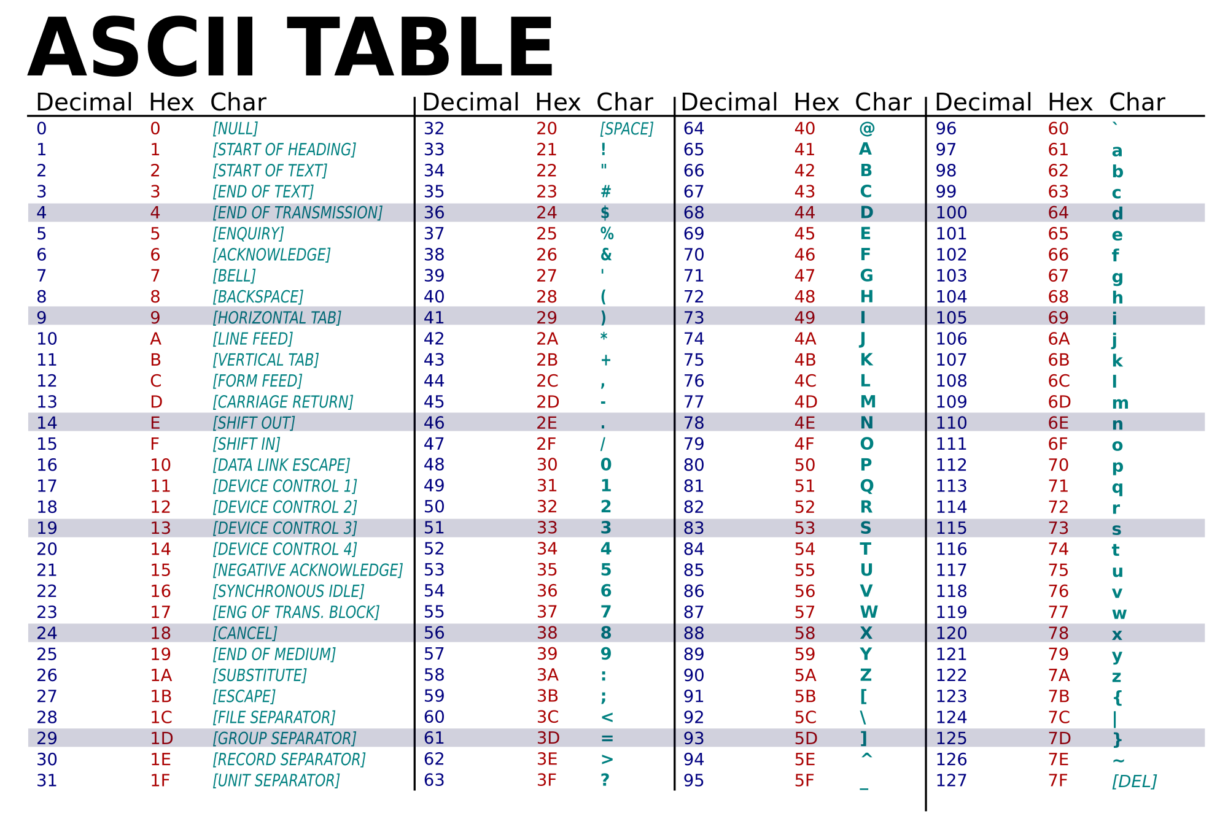

Slide 26
Characters
char ch1 = 'A';
char ch2 = 't';
char ch3 = ' ';
char ch4 = '\n';

Slide 27
Operations on Characters
C treats characters as small integers.
In ASCII, character codes range from 0000000 to 1111111, which we can think of as the integers from 0 to 127.
The character 'a' has the value 97, 'A' has the value 65, '0' has the value 48, and ' ' has the value 32.
Character constants actually have int type rather than char type.

Slide 28
Operations on Characters
When a character appears in a computation, C uses its integer value.
Consider the following examples, which assume the ASCII character set:
char ch;
int i;
i = 'a'; /* i is now 97 */
ch = 65; /* ch is now 'A' */
ch = ch + 1; /* what is ch now? */

Slide 29
Exercise
What is the value of char variable ch after the following statements?
char ch = 'b';
ch = ch + 3;
a) 'f'
b) 'd'
c) 'c'
d) 'e'

Slide 30
Operations on Characters
Characters can be compared, just as numbers can.
An if statement that converts a lower-case letter to upper case:
if (ch >= 'a' && ch <= 'z')
ch = ch - 'a' + 'A';
Comparisons such as 'a' <= ch are done using the integer values of the characters involved.

Slide 31
Operations on Characters
For example, write a for statement whose control variable steps through all the upper-case letters:
for (ch = 'A'; ch <= 'Z'; ch++) …

Slide 32
Reading and Writing Characters Using scanf and printf
The %c conversion specification allows scanf and printf to read and write single characters:
char ch;
scanf("%c", &ch); /* reads one character */
printf("%c", ch); /* writes one character */
scanf doesn’t skip white-space characters when reading characters.
char ch = ' '; //ch is 32
32

Slide 33
Using scanf
How to detect the end of an input line? check to see if the character just read is the new-line character.
A loop that reads and ignores all remaining characters in the current input line:
do {
scanf("%c", &ch);
} while (ch != '\n');
33

Slide 34
Using getchar
For single-character input and output, getchar and putchar are an alternative to scanf and printf. They are faster than scanf and printf.
Each time getchar is called, it reads one character, which it returns:
ch = getchar();
getchar returns an int value rather than a char value, so ch will often have type int.
Like scanf, getchar doesn’t skip white-space characters as it reads.

Slide 35
Using getchar
Consider the scanf loop that we used to skip the rest of an input line:
do {
scanf("%c", &ch);
} while (ch != '\n');
Rewriting this loop using getchar :
do {
ch = getchar();
} while (ch != '\n');

Slide 36
Using getchar
The loop we used to skip the rest of an input line:
do{
ch = getchar();
} while (ch != '\n');
Moving the call of getchar into the controlling expression allows us to condense the loop:
while ((ch = getchar()) != '\n')
;

Slide 37
Using getchar
getchar is useful in loops that skip characters as well as loops that search for characters.
A statement that uses getchar to skip an indefinite number of blank characters:
while ((ch = getchar()) == ' ')
;
When the loop terminates, ch will contain the first nonblank character that getchar encountered.

Slide 38
Example Program
Write a program to check if an input is a valid password:
Characters are alphabet or digit
Have 8 or more characters

Slide 39
Exercises

Slide 40
Exercise 1
Write a program that display the printable characters in the ASCII character set together with their integer values, separated by one white space.
32 //32 is white space
! 33
…
} 125
~ 126
The values for printable character are from 32 to 126.

Slide 41
Exercise 2
Write a program that displays the upper-case version of a message entered by the user. Use getchar().
The white space and punctuation should not be changed.
Enter a message: How are you?
Output: HOW ARE YOU?

Slide 42
Character-Handling Functions
Calling C’s toupper library function is a fast and portable way to convert case:
ch = toupper(ch);
toupper returns the upper-case version
Programs that call toupper need to have the following #include directive at the top:
#include <ctype.h>
Other useful functions in ctype.h: isdigit, isalpha…
Example: isalpha(ch) returns nonzero if ch is an alphabet, 0 otherwise
42

Slide 43
Exercise 3
Modify your program in Exercise 2 so it uses character handling functions to test whether a character is a letter and is lower case.

